Slide 1
UIT2201 – Programming and Data Structures
Inheritance in Python

Slide 2
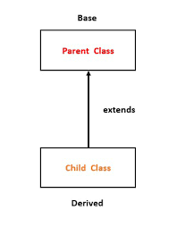
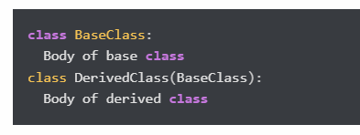
Inheritance
Inheritance is a powerful feature in object-oriented programming.
It refers to defining a new class with little or no modification to an existing class. The new class is called derived (or child) class and the one from which it inherits is called the base (or parent) class.

Slide 3
Characteristics of Inheritance
Inheritance makes objects (classes) special
Derive new classes from existing ones
Extend the definition of existing classes
Override method definitions of existing classes
Create objects of different classes in the same program
Allow objects to communicate with each other
Create more complex objects by combining simpler ones

Slide 4
Using Inheritance to Create New Classes
Inheritance: An element of OOP that allows a new class to be based on an existing one where the new automatically gets (or inherits) all the methods and attributes of the existing class
The children classes get all the capabilities (methods) and properties (attributes) the parent class has; the children classes are also called derived classes
Get the code for free! (code-reuse) – inheritance allows a new class to re-use code which already existed in another class (the parent class)

Slide 5
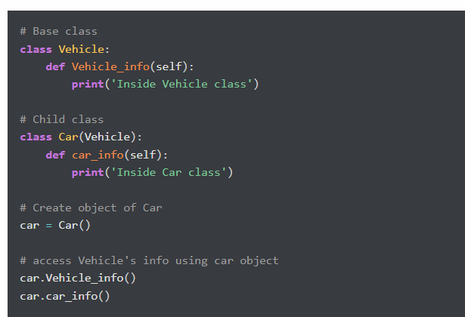
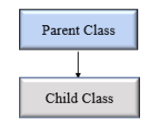
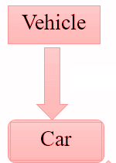
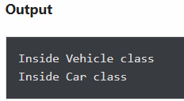
Single Inheritance Example

Slide 6
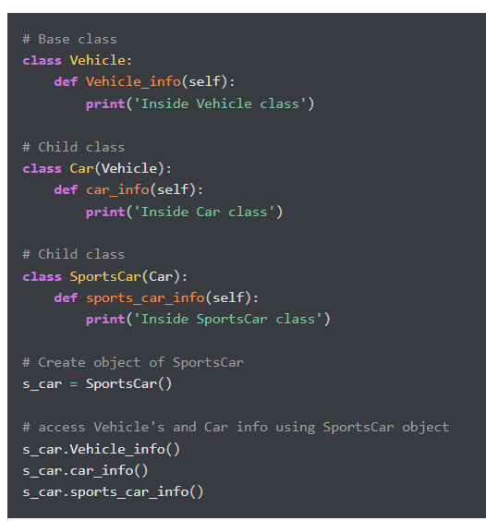
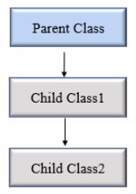
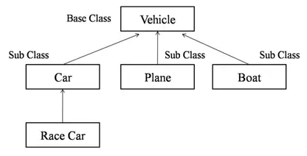
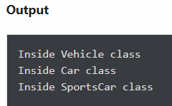
Multilevel inheritance

Slide 7
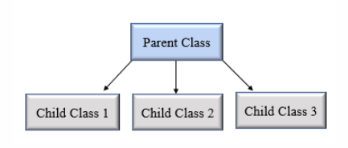
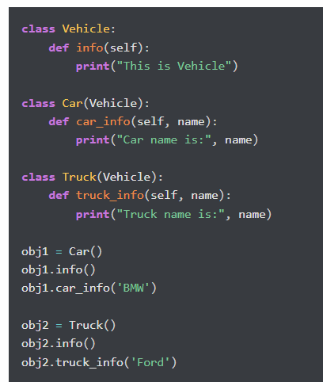
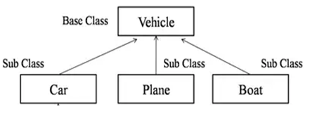
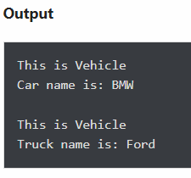
Hierarchical Inheritance

Slide 8
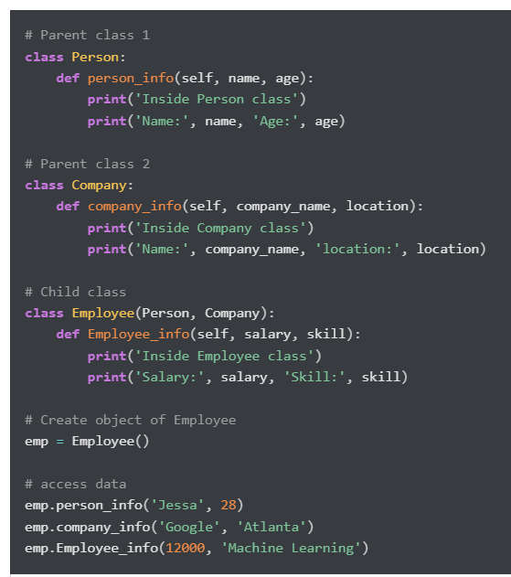
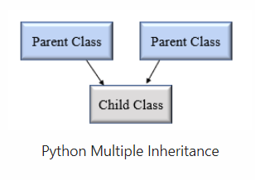
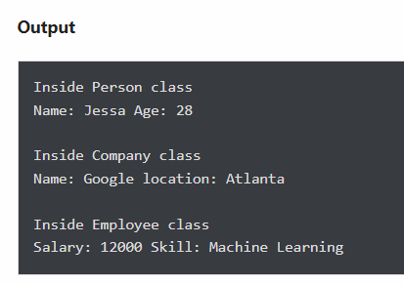
Multiple Inheritance

Slide 9
Python super() function
In child class, we can refer to parent class by using the super() function.
The super function returns a temporary object of the parent class that allows us to call a parent class method inside a child class method.
Benefits of using the super() function.
We are not required to remember or specify the parent class name to access its methods.
We can use the super() function in both single and multiple inheritances.
The super() function support code reusability as there is no need to write the entire function

Slide 10
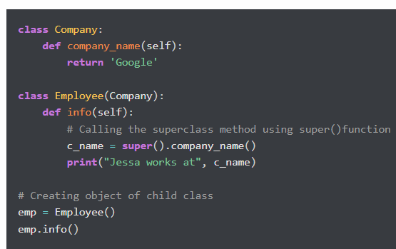
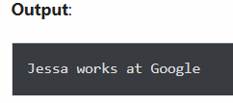
Python super() function

Slide 11
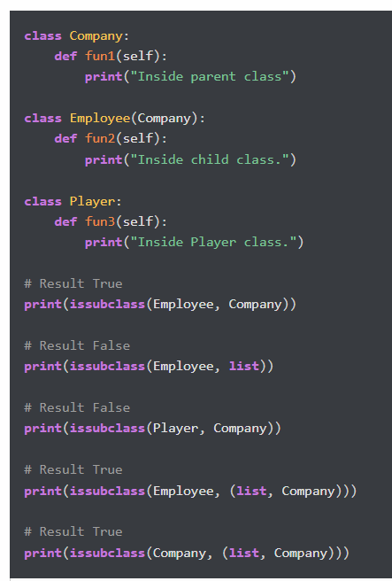
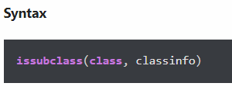
issubclass()
In Python, we can verify whether a particular class is a subclass of another class. For this purpose, we can use Python built-in function issubclass().
This function returns True if the given class is the subclass of the specified class. Otherwise, it returns False.

Slide 12
Method Overriding
In inheritance, all members available in the parent class are by default available in the child class. If the child class does not satisfy with parent class implementation, then the child class is allowed to redefine that method by extending additional functions in the child class. This concept is called method overriding.
When a child class method has the same name, same parameters, and same return type as a method in its superclass, then the method in the child is said to override the method in the parent class.

Slide 13
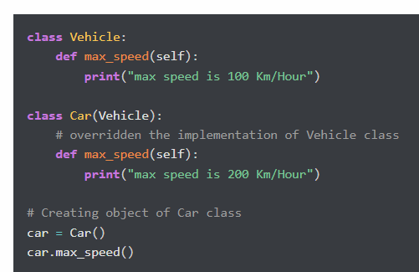
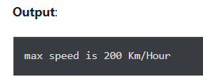
Method Overriding

Slide 14
Inheritance example

Slide 15
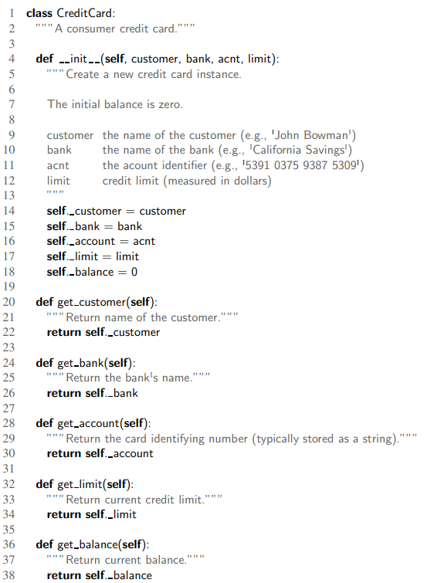
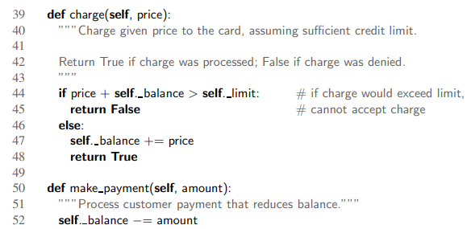
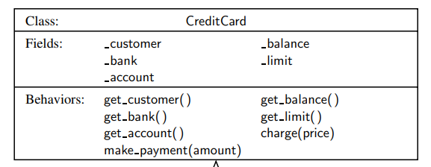
Credit Card Class

Slide 16
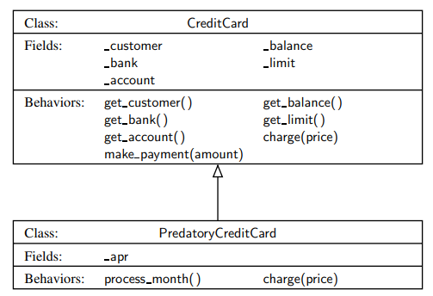
Inheritance Predatory Credit Card

Slide 17
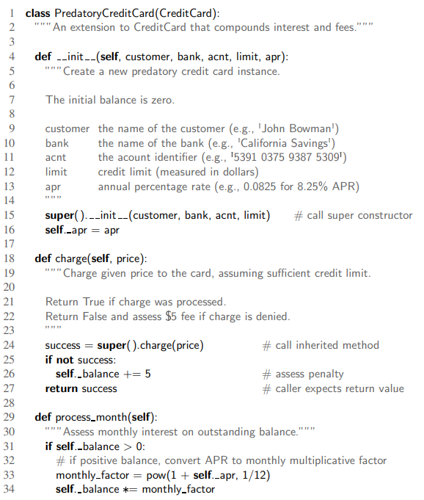
Predatory Credit Card inheritance example

